Slide 1

Purchase Amount Prediction & Insights:
An E-Commerce Business Case Study

Slide 2










BUSINESS PROBLEM STATEMENT
Global e-commerce firms struggle to accurately forecast purchase amounts and identify key revenue drivers across regions, devices, and payment methods. This limits strategic planning and revenue optimization. The objective is to apply machine learning to predict purchase amounts and deliver actionable, data-driven insights for better decision-making.

Slide 3
BUSINESS PROBLEM STATEMENT
Global e-commerce firms struggle to accurately forecast purchase amounts and identify key revenue drivers across regions, devices, and payment methods. This limits strategic planning and revenue optimization. The objective is to apply machine learning to predict purchase amounts and deliver actionable, data-driven insights for better decision-making.
Inaccurate Revenue Forecasting
Limited Visibility into Customer Spending Drivers
Ineffective Targeting of High-Value Customers
Suboptimal Regional and Payment Strategy
Underutilization of Transactional Data

Slide 4
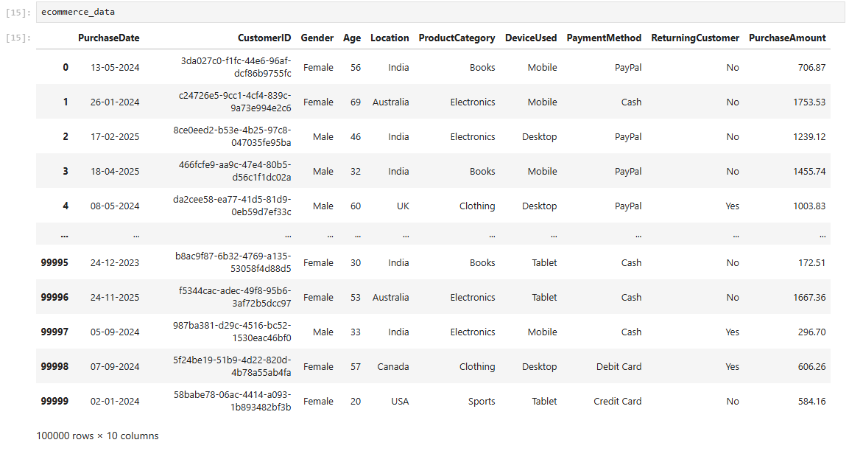
Business Problem Statement
DATA OVERVIEW

Slide 5
DATA OVERVIEW
Purchase Date
Customer ID
Unique Identifier a assigned to each customer (Str)
Gender of the Customer (Boolean)
Age
Product Category
Payment Method
Date On Which the Transaction was completed (Date & Time)
Gender
Country where the Transaction occurred (Str)
Age of the Customer at time of Purchase (Int)
Location
Category of Product Purchased (Str)
Device Used
Device used to complete the purchase (Str)
Returning Customer
Method used for Payment (Str)
Purchase Amount
Indicates whether the customer is a repeat buyer (Boolean)
Total monetary value of the Transaction (Target Variables) (Decimal)

Slide 6
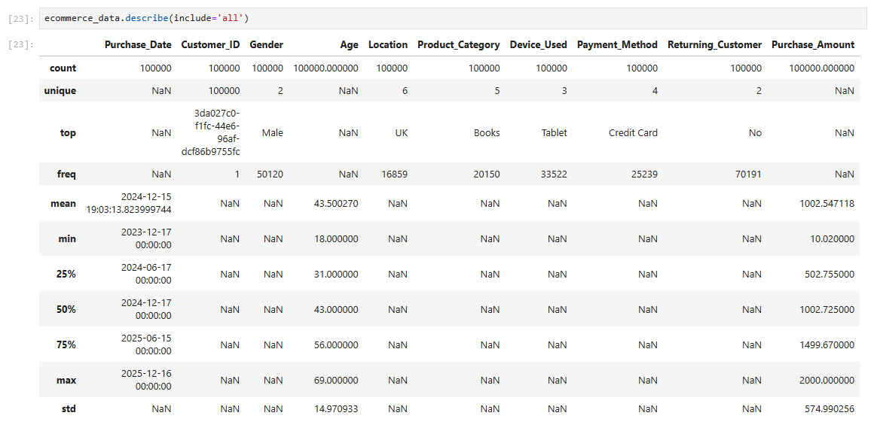
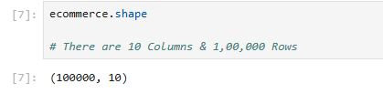
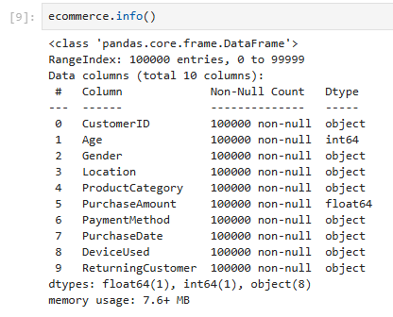
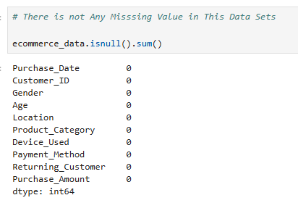
Business Problem Statement
INITIAL DATA EXPLORATION

Slide 7
INITIAL DATA EXPLORATION
The dataset contains 100,000 transaction records with 10 features, indicating sufficient volume for robust analysis and modeling.
All columns have 100% non-null values, confirming no missing data and high data quality.
The dataset includes a mix of numerical, categorical, and date variables, suitable for both analytics and machine learning.
PurchaseAmount ranges from 10 to 2000, showing wide spending variability across transactions.
The average purchase amount is approximately 1002, with a standard deviation of around 575, indicating high dispersion.
Customer age ranges from 18 to 69 years, with a median age of 43, representing a broad customer demographic.
The dataset spans purchases from December 2023 to December 2025, providing a meaningful time range for trend analysis.
Male customers appear most frequently among transactions, based on gender distribution.
Books is the most common product category, followed by other categories such as electronics and clothing.
Returning customers marked as “No” occur more frequently, indicating a higher proportion of first-time buyers.

Slide 8
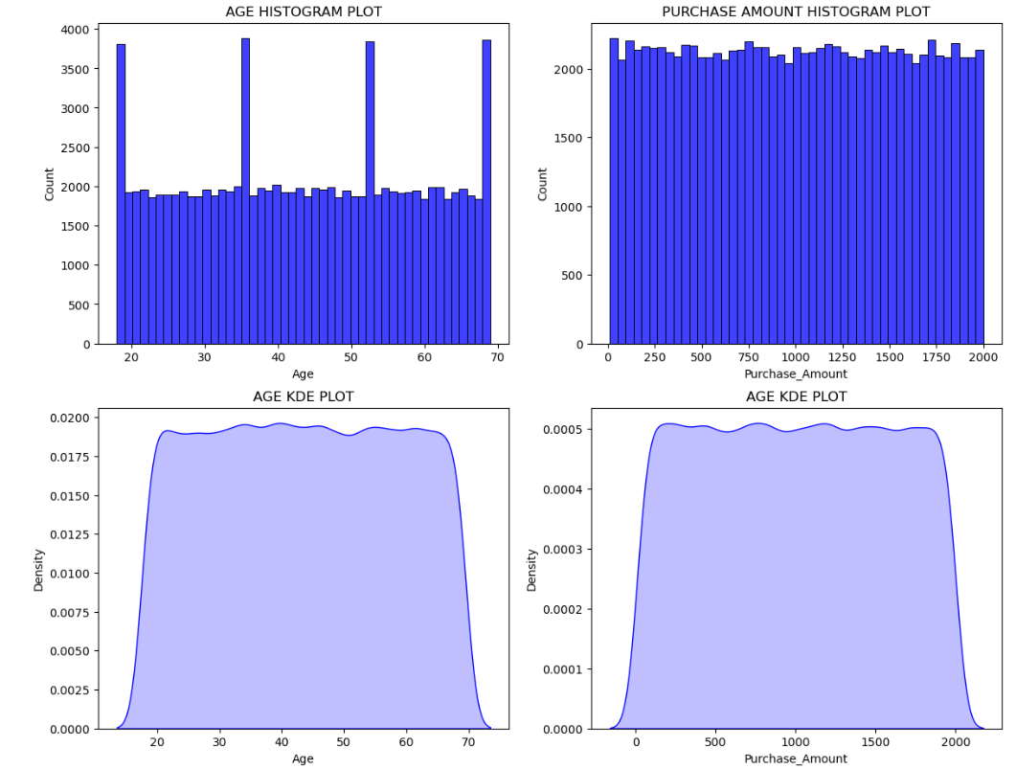
INITIAL DATA EXPLORATION
Customer age is evenly distributed between 18 and 69, indicating balanced representation across age groups.
No significant age skewness or concentration is observed, reducing bias in demographic-driven modeling.
Purchase amounts are uniformly spread across the full range, reflecting consistent spending behavior.
KDE plots confirm smooth, stable distributions, suggesting minimal noise and reliable patterns in the data.
Absence of extreme spikes or anomalies indicates clean data suitable for regression modeling without heavy outlier treatment.

Slide 9
DATA PREPROCESSING
Handling Missing Values
Handling Missing Values
Categorical Variable Encoding
Handling Missing Values
Feature Scaling
Train – Test Split
Conducted a missing value analysis and confirmed that the dataset contains no null or missing values, ensuring data completeness.
Split the dataset into 80% training data and 20% testing data to evaluate model generalization and predictive accuracy.
Applied Min–Max Scaling to independent variables to normalize feature ranges and improve model stability and performance.
Converted categorical features into numerical format using One-Hot Encoding to enable effective machine learning modeling.

Slide 10
DATA PREPROCESSING
Handling Missing Values
Feature Scaling
Train – Test Split
Handling Missing Values
Handling Missing Values
Categorical Variable Encoding
Conducted a missing value analysis and confirmed that the dataset contains no null or missing values, ensuring data completeness.
Converted categorical features into numerical format using One-Hot Encoding to enable effective machine learning modeling.
Applied Min–Max Scaling to independent variables to normalize feature ranges and improve model stability and performance.
Split the dataset into 80% training data and 20% testing data to evaluate model generalization and predictive accuracy.

Slide 11
ENCODING STRATEGY
Encoding Decisions Overview :-
  Different encoding techniques were applied based on the nature of each categorical variable and model assumptions.
Encoding Approach Used :-
  Binary Encoding (Label Mapping) Applied To
  Gender: Male = 1, Female = 0
  Returning Customer: Yes = 1, No = 0
  Reason :- These variables are binary and non-ordinal, making numeric mapping appropriate and model-safe.
One-Hot Encoding Applied To :-
  Location (Country)
  Product Category
  Reason :-
    Categories have no natural order
    Prevents misleading numerical relationships
    Ensures fair contribution of each category in linear regression
Business & Model Benefit :-
  Preserves correct feature interpretation
  Improves model stability and accuracy
  Aligns encoding strategy with regression assumptions

Slide 12
BASELINE MODEL
Model Selection
  Applied Linear Regression as the baseline model to predict Purchase Amount
Features Used
  Demographic Features: Age, Gender, Location
  Behavioral & Category Features: Product Category, Returning Customer
Model Assumptions
  Assumes a linear relationship between independent variables and purchase amount
  Assumes independence of observations and additive feature effects
  Suitable as a benchmark model for performance comparison
Purpose of the Model
  Establish a baseline predictive performance
  Understand feature influence through interpretable coefficients
  Identify limitations before applying advanced models

Slide 13
INITIAL MODEL PERFORMANCE
Key Performance Metrics
  MAE: 0.71
  MAPE: 0.13 (13%)
  RMSE: 0.93
  R² Score: ~0.00
Performance Interpretation
  Low MAE and RMSE indicate predictions are numerically close to the average purchase value
  However, R² near zero shows the model explains almost none of the variability in purchase amounts
  Model fails to capture patterns beyond the overall mean
Key Observation
  Underfitting detected
  Predictions are overly simplistic and cluster around the mean, ignoring customer and category differences
Business Impact
  Limited usefulness for decision-making
  Inadequate for identifying high-value customers or revenue drivers
Decision & Next Step
  Treat Linear Regression as a baseline benchmark only
  Proceed with non-linear models (Random Forest, XGBoost) to capture complex spending behavior

Slide 14
INITIAL MODEL PERFORMANCE
Key Performance Metrics
  MAE: 0.71
  MAPE: 0.13 (13%)
  RMSE: 0.93
  R² Score: ~0.00
Metrics | Value
Mean Absolute Error | 0.71
Mean Absolute Percentage Error | 0.13 (13%)
Mean Squared Error | 0.87
Root Mean Squared Error | 0.93
R2 Score | 0.0
Performance Interpretation
  Low MAE and RMSE indicate predictions are numerically close to the average purchase value
  However, R² near zero shows the model explains almost none of the variability in purchase amounts
  Model fails to capture patterns beyond the overall mean
Key Observation
  Underfitting detected
  Predictions are overly simplistic and cluster around the mean, ignoring customer and category differences
Business Impact
  Limited usefulness for decision-making
  Inadequate for identifying high-value customers or revenue drivers
Decision & Next Step
  Treat Linear Regression as a baseline benchmark only
  Proceed with non-linear models (Random Forest, XGBoost) to capture complex spending behavior

Slide 15
ERROR ANALYSIS
Represents the average absolute difference between predicted and actual purchase amounts
Measures average prediction error as a percentage
Linear relationships were insufficient to capture complex customer spending behavior
High variability and non-linear patterns in purchase amounts reduced linear model accuracy
Errors indicate underfitting, where the model oversimplifies patterns and predicts values close to the mean

Slide 16
ERROR ANALYSIS
Represents the average absolute difference between predicted and actual purchase amounts
Measures average prediction error as a percentage
Linear relationships were insufficient to capture complex customer spending behavior
High variability and non-linear patterns in purchase amounts reduced linear model accuracy
Errors indicate underfitting, where the model oversimplifies patterns and predicts values close to the mean

Slide 17
FEATURE ENGINEERING STRATEGY
MODEL IMPROVEMENT APPROACH
Log Transformation of Target Variable
Applied log / log1p transformation to the purchase amount
Reduced skewness and stabilized variance
Improved model learning by handling high-value transactions effectively
Feature Scaling of Independent Variables
Used Min–Max Scaling to normalize feature ranges
Ensured consistent contribution of all features
Enhanced model convergence and numerical stability
Log-Scale Training
Trained models on log-transformed purchase amounts
Reduced skewness and impact of extreme values
Improved model stability and prediction consistency
Enabled better learning of relative spending differences
Improved Encoding Strategy
Applied one-hot encoding for multi-category variables
Used binary encoding for true binary features
Prevented artificial ordinal relationships
Enhanced interpretability and coefficient reliability
Why This Strategy Matters
Improves prediction accuracy
Reduces impact of outliers
Aligns data with model assumptions
Model Tuning
Optimized model parameters to reduce bias and variance
Improved learning capacity beyond baseline performance
Balanced model complexity and generalization
Achieved better fit to underlying data patterns
Error-Focused Optimization
Evaluated models using MAE, MAPE, RMSE, and R²
Focused on reducing business-relevant errors (MAE, MAPE)
Analyzed residuals to detect underfitting
Guided selection of more advanced, non-linear models

Slide 18


